Slide 1
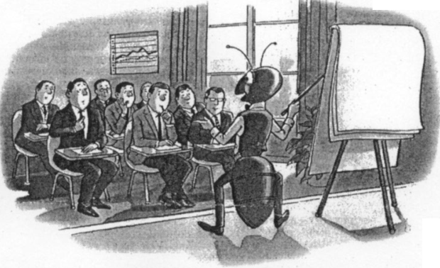
Swarm Algorithms

Slide 2
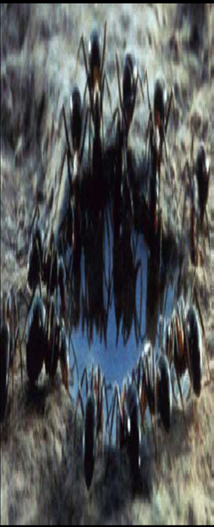
A social insect colony is...
Flexible
Robust
Decentralized
Self-organized
~ 10²-10^{<<23} units
~ identical
~ short range

Slide 3
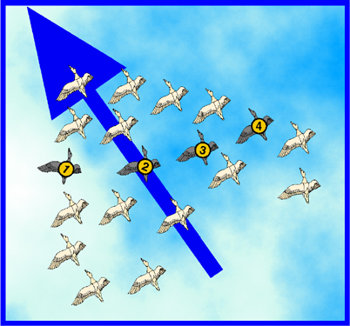
Swarm Algorithms, Briefly
There are two popular swarm inspired methods
in computational intelligence areas:
Ant colony optimization (ACO)
particle swarm optimization (PSO)

Slide 4
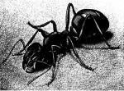
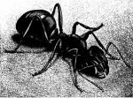
Swarm Algorithms, Briefly
Idea:
Each insect in a swarm is local search process
At each step, each insect:
Looks around its neighborhood
Decides which direction looks best
Communicates what it found out to (some of) the other insects
According to a random coin flip,
Moves in the direction that looks best locally
Moves in the best direction it hears about
Moves in some weighted combination of the above

Slide 5
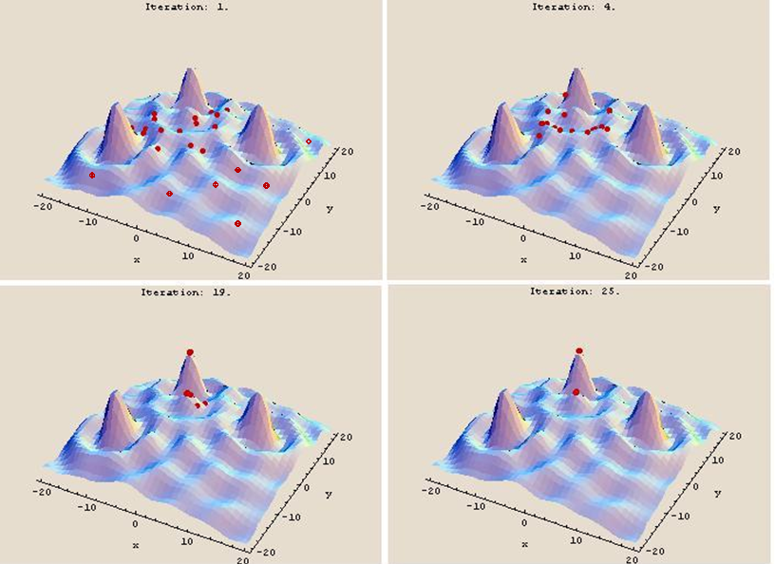
Example: Particle Swarm Optimization

Slide 6
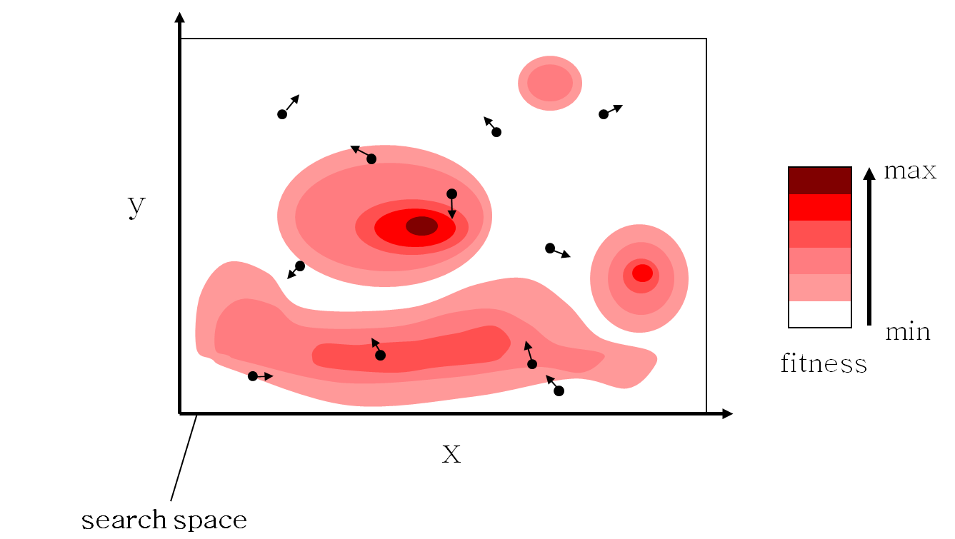
Example

Slide 7
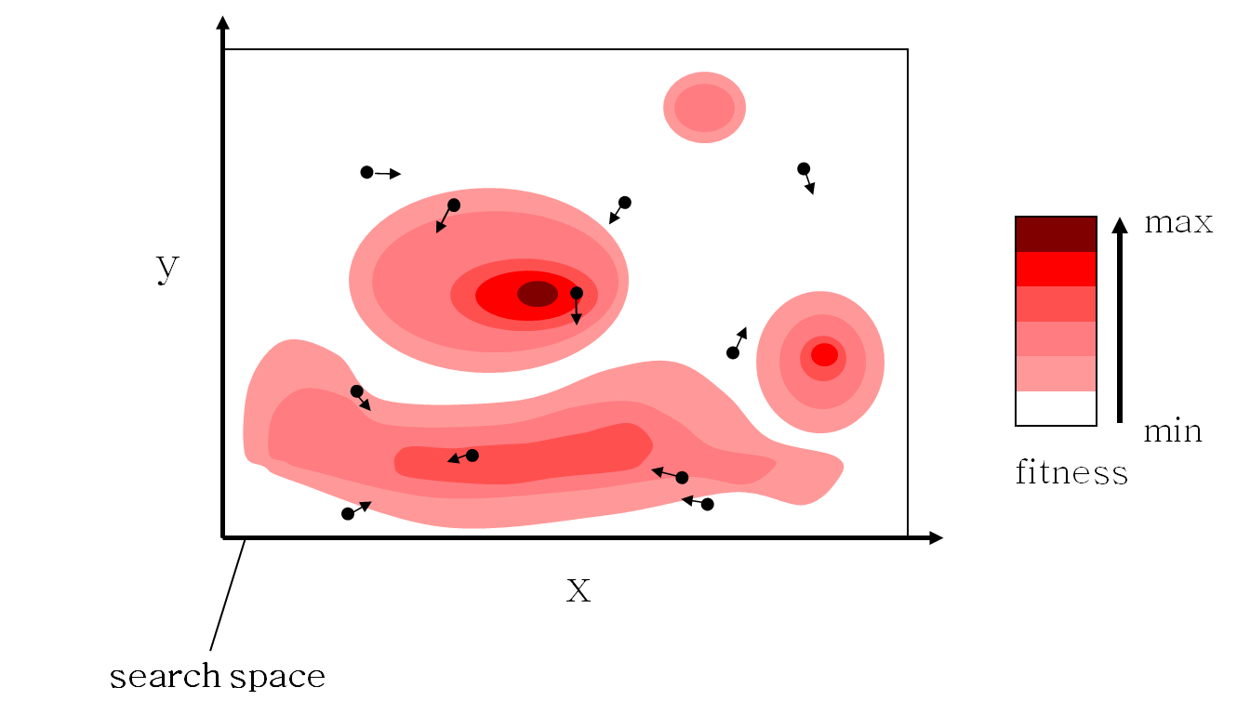
Example

Slide 8
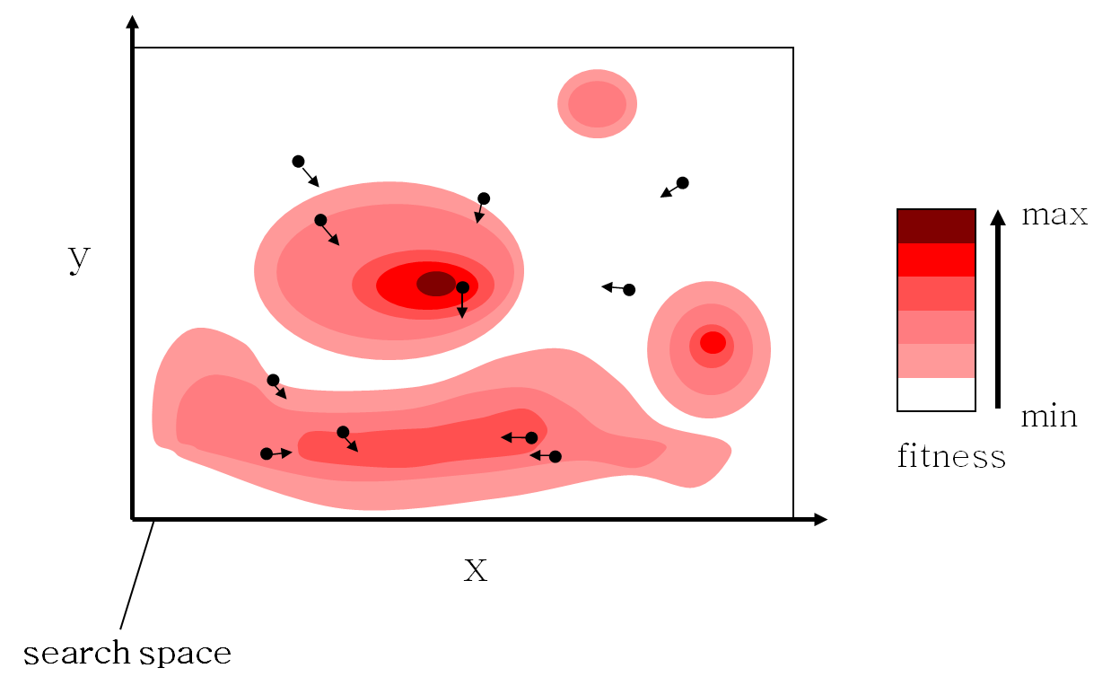
Example

Slide 9

Example

Slide 10

Example

Slide 11
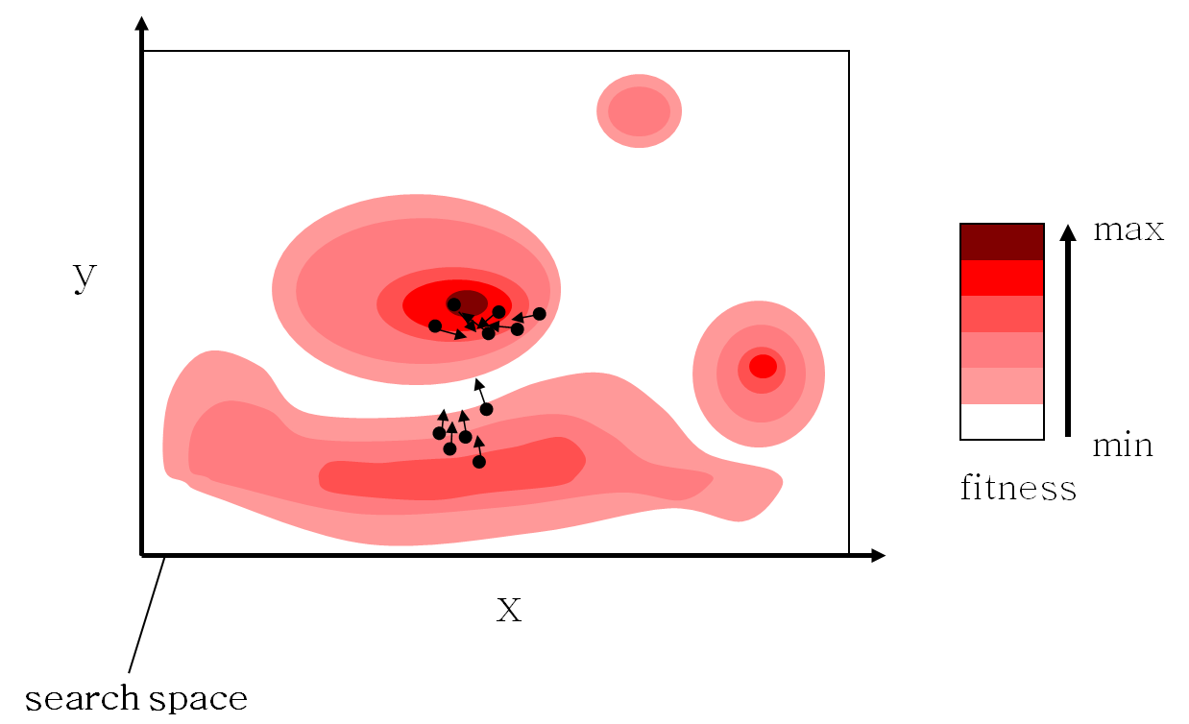
Example

Slide 12
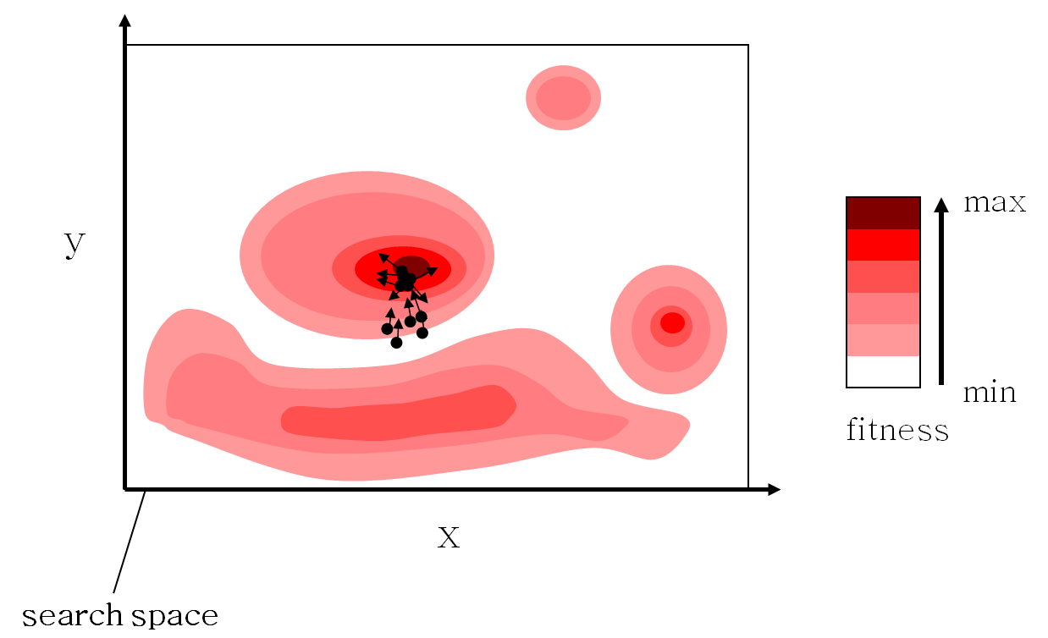
Example

Slide 13

Example

Slide 14
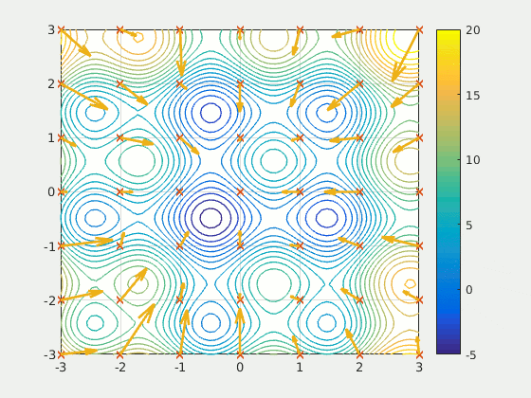
Example: PSO

Slide 15
PSO Overview
Developed with Dr. Eberhart and Dr. Kennedy in 1995, Bureau of Labor Statistics, Washington, DC
A concept for optimizing nonlinear functions using particle swarm methodology
Has roots in artificial life and evolutionary computation
Simple in concept
Easy to implement
Computationally efficient
Effective on a wide variety of problems
Insensitive to scaling of design variables
Easily parallelized for concurrent processing
Derivative free
Very few algorithm parameters

Slide 16
Particle Swarm Optimization
Swarm: a set of particles (S)
Particle: a potential solution
Position:
Velocity:
Each particle maintains
Individual best position (PBest)
Swarm maintains its global best (GBest)
Fitness function
Fitness value
S

Slide 17
PSO Process
Initialize population in hyperspace
- V_{id} randomly generated with the range [-Vmax, Vmax]
Evaluate fitness of individual particles
Modify velocities based on previous best and global (or neighborhood) best
Terminate on some condition
Go to step 2

Slide 18
PSO Algorithm
Original velocity update equation
w,c₁,c₂: Constant
random₁(), random₂(): random variable
Position update

Slide 19
Algorithm - Parameters
Number of particles usually between 10 and 50
In PSO, particles never die!
C1 is the importance of personal best value
C2 is the importance of neighborhood best value
Usually C1 + C2 = 4 (empirically chosen value)
If velocity is too low → algorithm too slow
If velocity is too high → algorithm too unstable

Slide 20
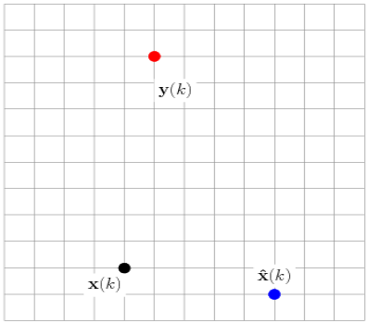
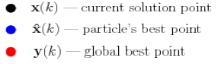
PSO solution update in 2D
GBest
PBest
x(k) - Current solution (4, 2)
PBest - Particle’s best solution (9, 1)
GBest-Global best solution (5, 10)

Slide 21
PSO Algorithm
Particle’s velocity
x(k+1)
PBest
GBest
social
v(k+1)
cognitive
v(k)
x(k)
Inertia

Slide 22
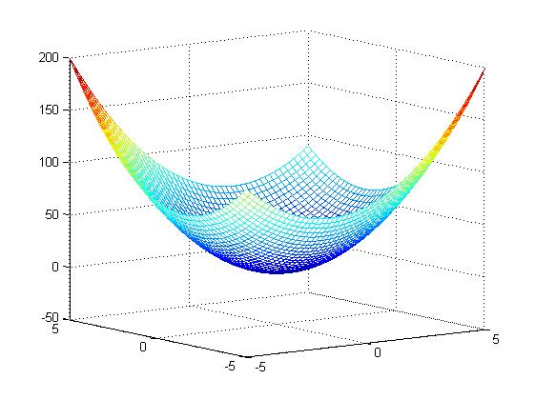
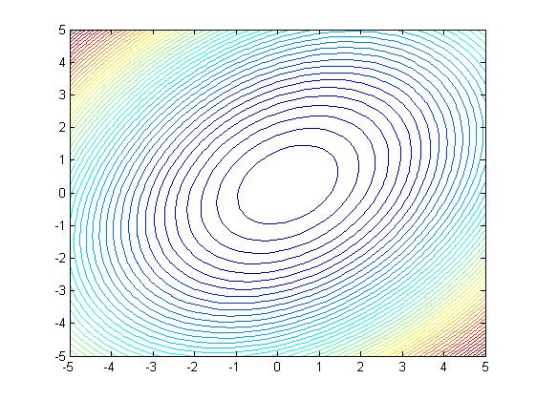
Example
Find the minimum of this function

Slide 23
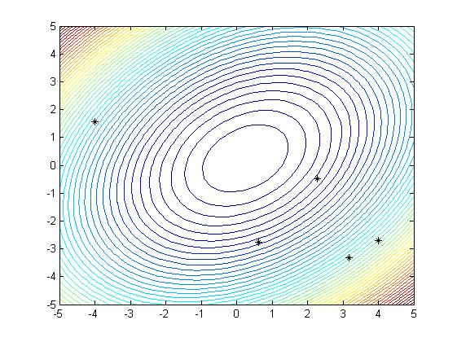
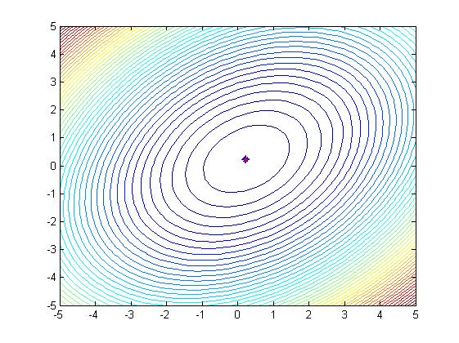
Example
…

Slide 24
V_{MAX}
An important parameter in PSO; sometimes the only one adjusted
Clamps particles’ velocities on each dimension
Determines “fineness” with which regions are searched
If too high, can fly past optimal solutions
If too low, can get stuck in local minima

Slide 25
PSO Initial Version
Fundamental assumptions seem to be upheld: Social sharing of information among speciates provides an evolutionary advantage
PSO has a memory: it is thus related to the “elitist” version of GAs
Disadvantages
Tendency to a fast and premature convergence in mid optimum points
Slow convergence in refined search stage (weak local search ability)

Slide 26
PSO
There are two ways that particles can be updated:
Synchronously
Asynchronously
Asynchronous update allows for newly discovered solutions to be used more quickly

Slide 27
Swarm Topology
In PSO, there have been two basic topologies used in the literature
Ring Topology (neighborhood of 3)
Star Topology (global neighborhood)
I₀
I₀
I₁
I₁
I₄
I₄
I₃
I₂
I₃
I₂

Slide 28
PSO for the BPP: Problem Formulation
Multi-Objective 2D BPP
Maximum of I bins with width W and height H
J items with w_{j} ≤ W, h_{j} ≤ H and weight ψ_{j}
Objectives
Minimize the number of bins used K
Minimize the average deviation between the overall centre of gravity and the desired one

Slide 29
PSO for the BPP: Problem Formulation
6 classes with 20 instances randomly generated
Size range:
Class 1: [0, 100]
Class 2: [0, 25]
Class 3: [0, 50]
Class 4: [0, 75]
Class 5: [25, 75]
Class 6: [25, 50]
Class 2: small items → more difficult to pack

Slide 30
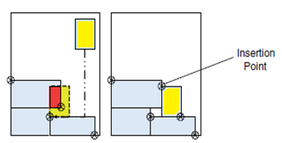
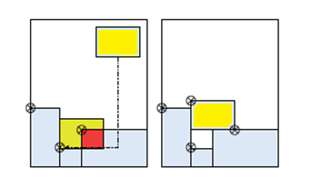
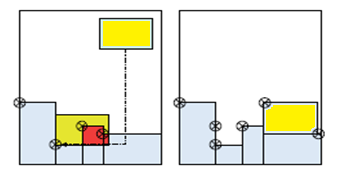
PSO for the BPP: Initialization BLF
Item moved to the right if
intersection detected at the top
Item moved to the top if
intersection detected at the right
Item moved if there is a lower available space for insertion

